Slide 1
Object Oriented Design of Assembler
Prepared By: Er. Saugat Niroula

Slide 2
Object-oriented design can be viewed in different ways.
Booch (1994) suggests that there are really two different development processes, which he calls micro and macro.

Slide 3
Booch Macro Processes
Booch’s macro process represents the overall activities of the development team on a long-range scale (perhaps many months at a time).
It includes the following activities:

Slide 4
Booch Macro Processes
Establish the requirements for the software (conceptualization)
Develop an overall model of the system’s behavior (analysis)
Create an architecture for the implementation (design)
Develop the implementation through successive refinements (evolution)
Manage the continued evolution of a delivered system (maintenance)

Slide 5
This macro process repeats itself after each major release of a software product. The overall sequence of events is similar to the waterfall model
However, Booch argues that object-oriented development is inherently iterative.

Slide 6
Booch’s Micro Processes
Booch’s micro process essentially represents the daily activities of the system developers. It consists of the following activities:
  Identify the classes and objects of the system
  Establish the behavior and other attributes of the classes and objects—for example, the methods that are applicable to each
  Analyze the relationships among the classes and objects—for example, the use of aggregation, inheritance and polymorphism
  Specify the implementation of the classes and objects—for example, the data structures and algorithms that are used in each
These activities may be repeated as needed, with increasing levels of detail being considered.

Slide 7
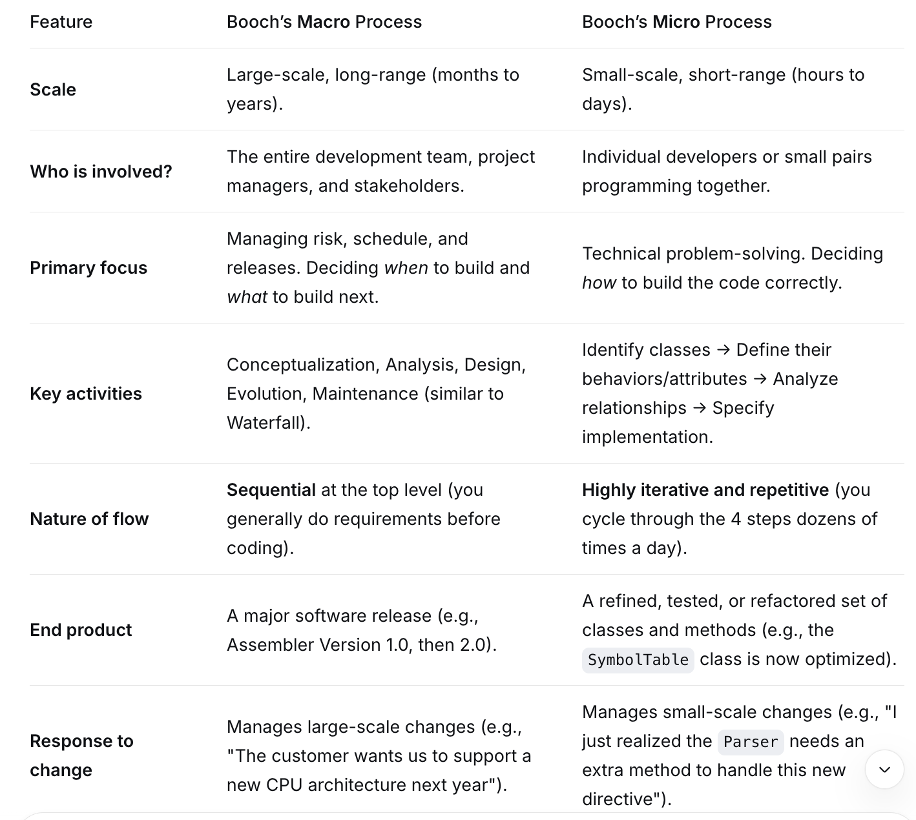

Slide 8
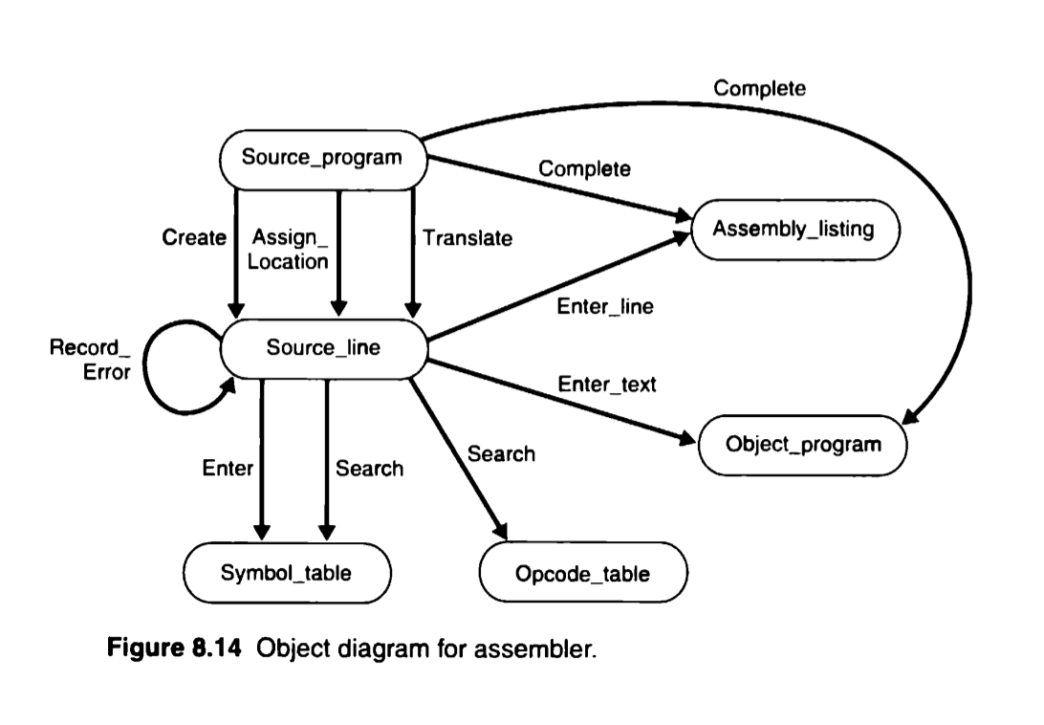
Object Diagram of Assembler

Slide 9
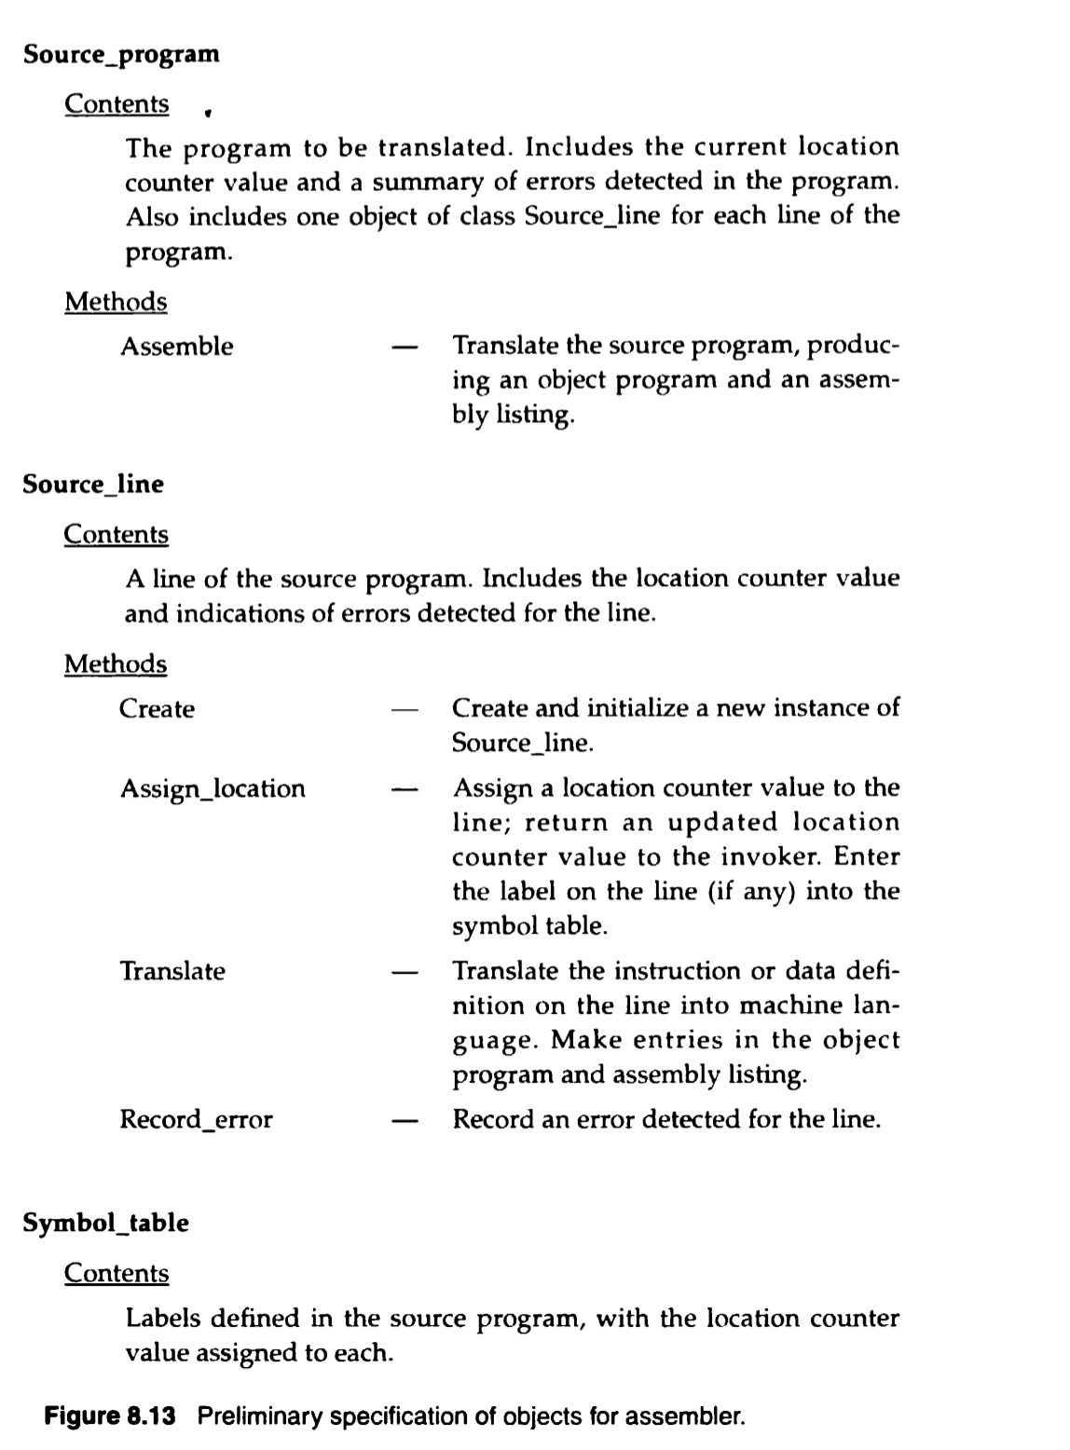

Slide 10
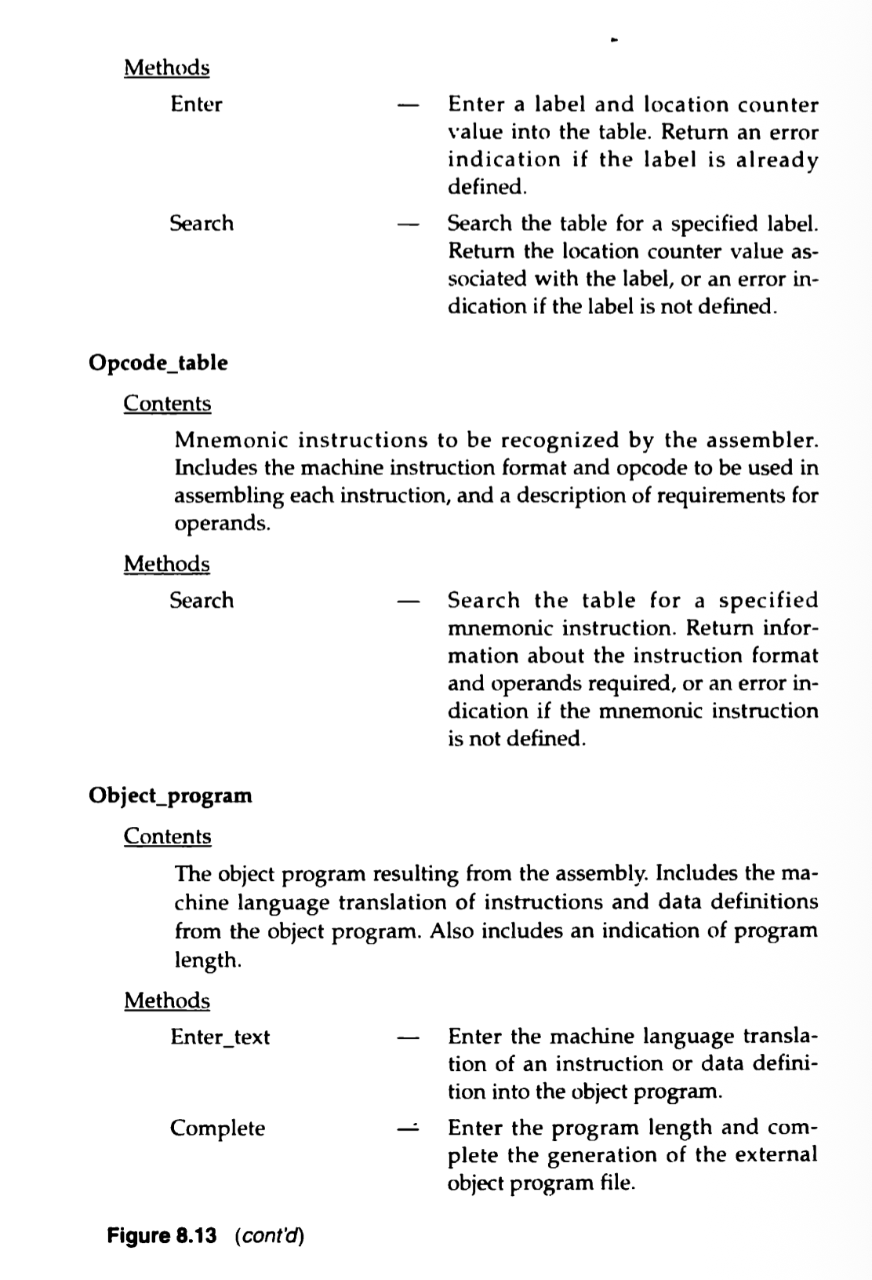

Slide 11
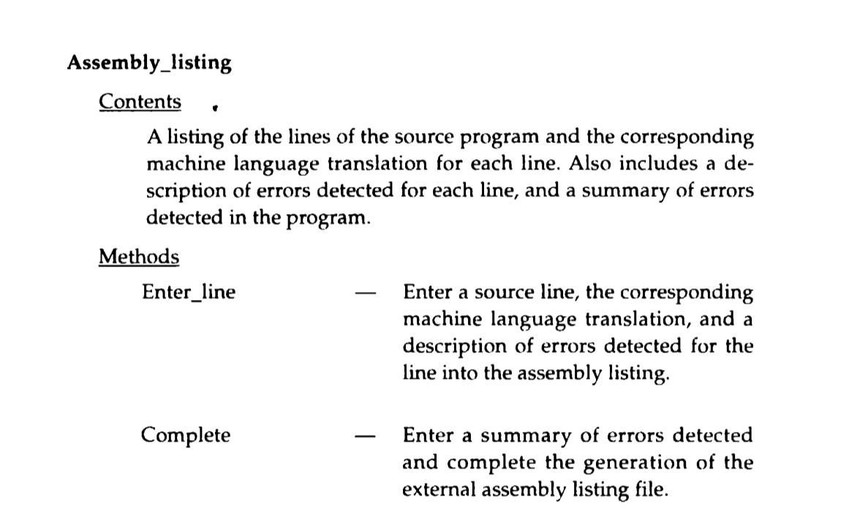

Slide 12
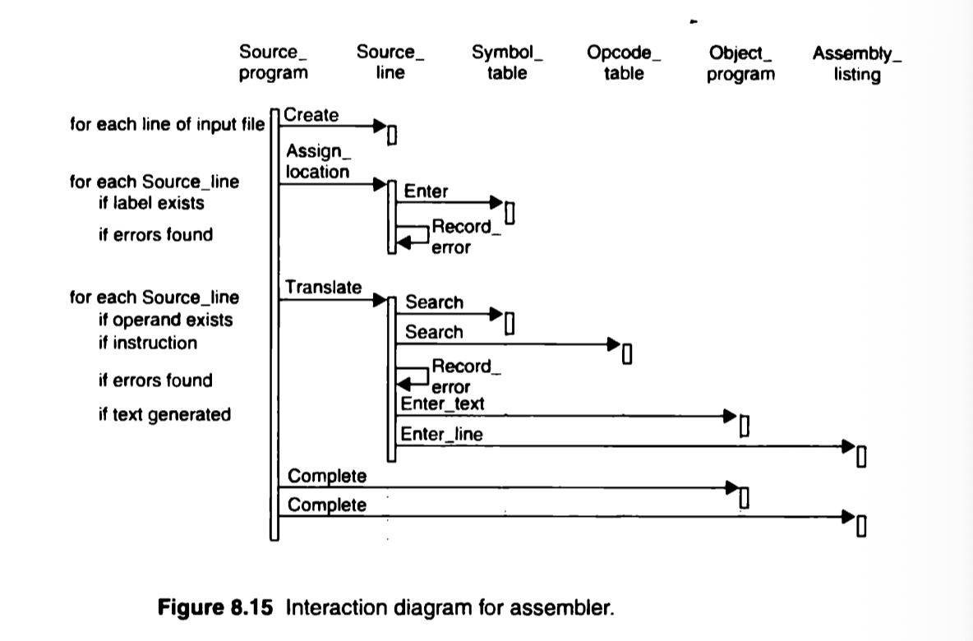
Interaction diagram of Assembler

